Slide 1
UNIVERSITY INSTITUTE OF ENGINEERING
Department of Computer Science & Engineering
Databases Management System
(23CSH-205/23ITH-205)
DR. GITANJALI
E16525
ASSISTANT PROFESSOR
CSE
DISCOVER . LEARN . EMPOWER

Slide 2
ABOUT COURSE
The main DBMS course, we learn about the structural formation of data, maintain data integrity, multitasking with concurrent access and recovery without occurring crashes, data structures, data models etc. and their working in which every organization is based.
At the end of the course, the students may understand the concepts of data structures, data models and design, construction of queries by using SQL, uses and applications of database design etc

Slide 3
COURSE OUTCOMES
CO No. | Title | BT Level
CO1 | Students will be able to understand the database system concepts and design databases for different applications. | Memorize
CO2 | Students will be able to identify different types of DDL, DML, DCL and TCL commands and their usage. | Understanding
CO3 | Students will be able to classifying Normalization, Dependencies and Denormalization along with their requirements. | Apply
CO4 | Students will be able to analyse and Compare Transaction Processing techniques and Recovery techniques. | Analyze
CO5 | Students will be able to evaluate database performance after implementing Triggers, procedures, packages, cursors and views. | Evaluate
Will be covered in this lecture

Slide 4
COURSE OBJECTIVES
This course will enable students to,
To have good understanding of database system concepts and design databases for different applications.
To learn how to use a DBMS and RDBMS.
To implement and understand different types of DDL, DML and DCL statements.
To understand transaction concepts related to databases and recovery/backup techniques required for the proper storage of data.

Slide 5
Topics covered
Package, Procedures and Triggers
Parts of procedures, Parameter modes, Advantages of procedures, Syntax for creating triggers, Types of triggers, package specification and package body, developing a package, Bodiless package, Advantages of packages.

Slide 6

Package
PL/SQL packages are a way to organize and encapsulate related procedures, functions, variables, triggers, and other PL/SQL items into a single item. Packages provide a modular approach to write and maintain the code. It makes it easy to manage large codes.
A package is compiled and then stored in the database, which then can be shared with many applications. The package also has specifications, which declare an item to be public or private. Public items can be referenced from outside of the package.
A PL/SQL package is a collection of related Procedures, Functions, Variables, and other elements that are grouped for Modularity and Reusability.
Package

Slide 7

Package
Key Benefits of Using PL/SQL Packages
Modularity: Packages provide a modular structure, allowing developers to organise and manage code efficiently.
Code Reusability: Procedures and functions within a package can be reused across multiple programs, reducing redundancy.
Private Elements: Packages support private procedures and functions, limiting access to certain code components.
Encapsulation: Packages encapsulate related logic, protecting internal details and promoting a clear interface to other parts of the code.

Slide 8
Package
Developing a Package
Structure of a PL/SQL Package
A PL/SQL package consists of two parts:
A package Specification
A package Body
Package
Package Specification
Package Body

Slide 9
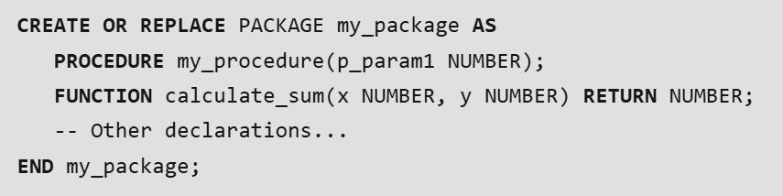
Package
1. Package Specification
The package specification declares the public interface of the package. It includes declarations of procedures, functions, variables, cursors, and other constructs that are meant to be accessible from outside the package. The specification is like a header file that defines what a package can do.
Example of Package Specification:

Slide 10
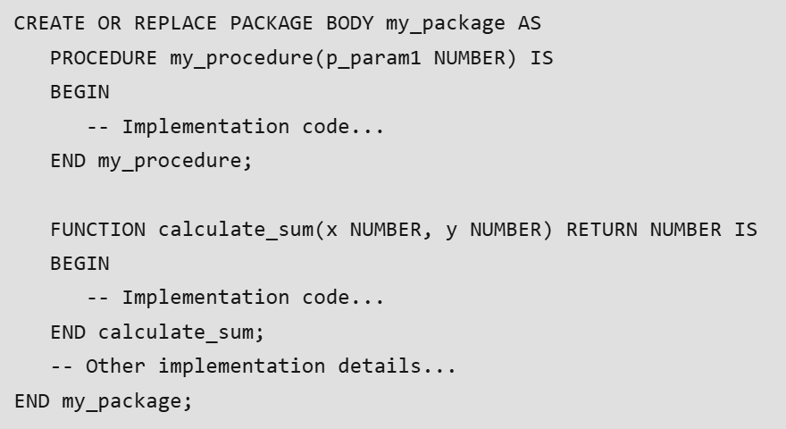
Package
2. Package Body
The package body contains the implementation of the details of the package. It includes the coding of the procedures or functions which are decalared in the package specification. The body can also contain private variables and procedures that are not exposed to outside the code.
Example of Package Body:

Slide 11
Package
Bodiless Package
A bodiless package in PL/SQL refers to a package that does not require a package body. In such cases, only the package specification is created, and it contains all the declarations of variables, constants, cursors, or subprograms. However, the package body is omitted because no implementation is required.
When to Use Bodiless Packages?
Public Declarations Only: If the package contains only public variables, constants, or cursors and does not need any subprogram implementation.
Forward Declarations: When subprograms (procedures/functions) are declared but implemented elsewhere (e.g., standalone procedures or functions).
Minimal Complexity: If the package is used as a simple interface to expose global variables or cursors.

Slide 12
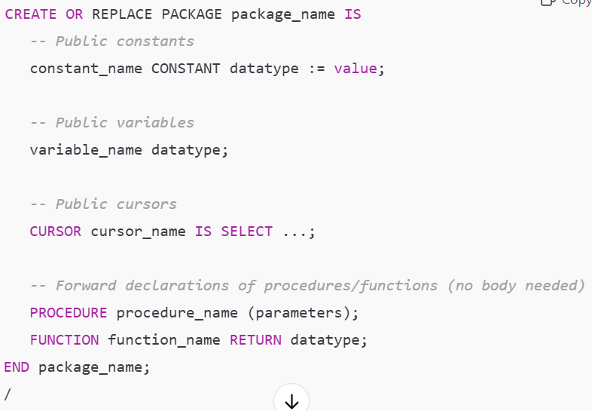
Package
Syntax of a Bodiless Package

Slide 13
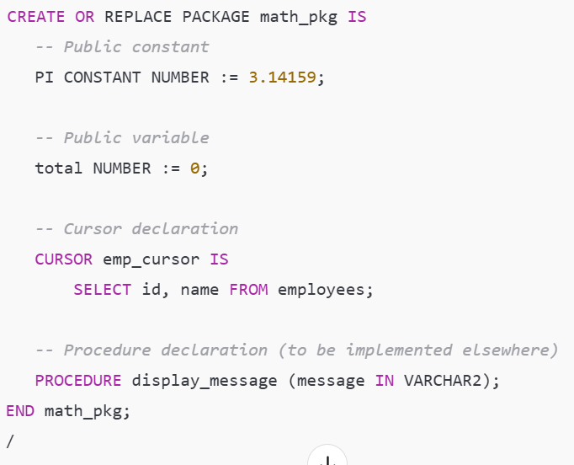
Package
Example of a Bodiless Package

Slide 14
Package
Advantages of Bodiless Packages
Simplified Structure: No need for a body when implementation is not required.
Improved Readability: Only the interface (specification) is provided, making it easy to understand.
Reusability: Useful for sharing global variables, constants, or cursors across multiple PL/SQL programs.
Forward Compatibility: You can add a package body later if needed.
Disadvantages of Bodiless Packages
No Implementation of Logic: Since a bodiless package only contains declarations, you cannot implement procedures, functions, or complex logic within the package.
No Encapsulation: Encapsulation of internal logic is not possible without a package body.

Slide 15
Procedures
PL/SQL procedures are reusable code blocks that perform specific actions or logic within a database environment. They consist of two main components such as the procedure header which defines the procedure name and optional parameters and the procedure body which contains the executable statements implementing the desired business logic.
1. Procedure Header
The procedure header includes the procedure name and optional parameter list.
It is the first part of the procedure and specifies the name and parameters
2. Procedure Body
The procedure body contains the executable statements that implement the specific business logic.
It can include declarative statements, executable statements, and exception-handling statements

Slide 16
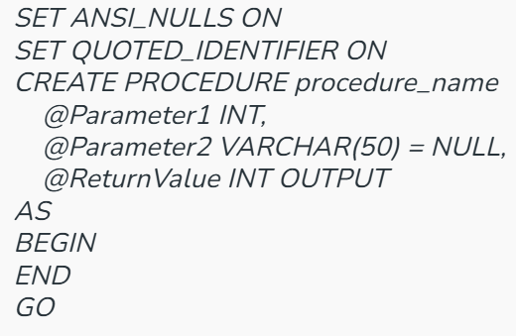
Procedures
Create Procedures in PL/SQL
Syntax
CREATE PROCEDURE syntax is:

Slide 17
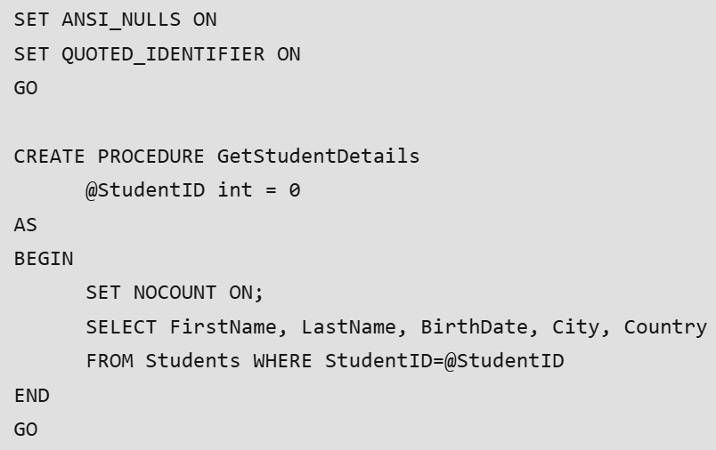
Procedures Example
In this example, we will create a procedure in PL/SQL

Slide 18
Procedures
Parameters in Procedures
In PL/SQL, parameters are used to pass values into procedures. There are three types of parameters used in procedures:
1. IN parameters
Used to pass values into the procedure
Read-only inside the procedure
Can be a variable, literal value, or expression in the calling statement.
2. OUT parameters
Used to return values from the procedure to the calling program
Read-write inside the procedure
Must be a variable in the calling statement to hold the returned value
3. IN OUT parameters
Used for both passing values into and returning values from the procedure
Read-write inside the procedure
Must be a variable in the calling statement

Slide 19
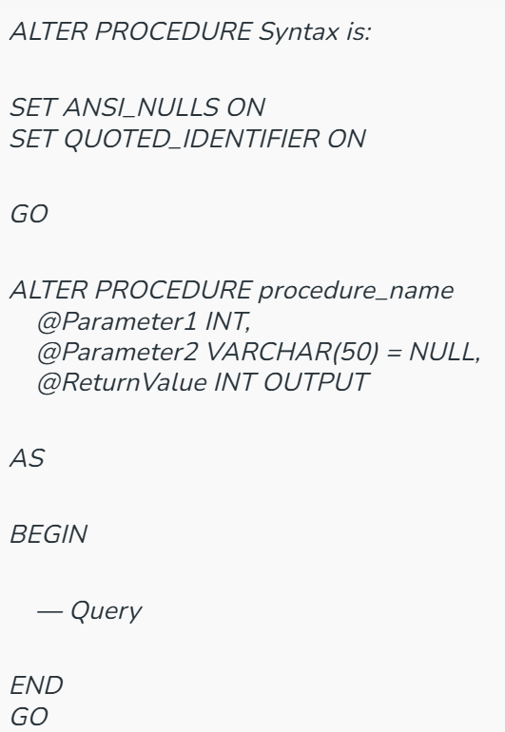
Procedures
Modify Procedures in PL/SQL
To modify an existing procedures in PL/SQL use the ALTER PROCEDURE command:
Syntax

Slide 20
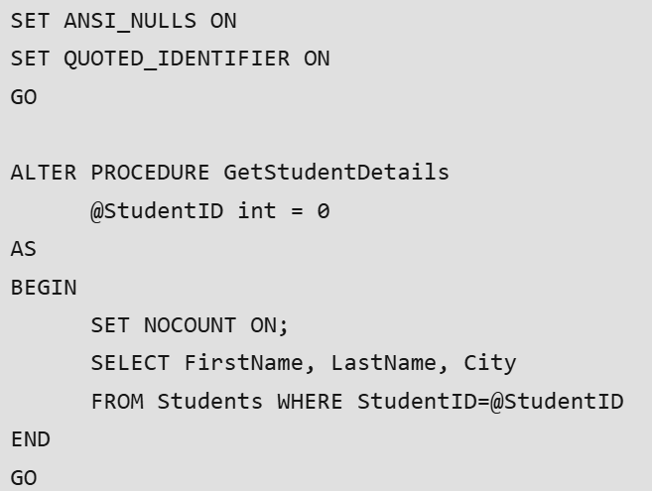
Procedures
Example
In this example, we will modify a procedure in PL/SQL

Slide 21
Procedures
Drop Procedure in PL/SQL
To drop a procedure in PL/SQL use the DROP PROCEDURE command
Syntax:
DROP PROCEDURE procedure_name
PL/SQL DROP PROCEDURE Example
In this example, we will delete a procedure in PL/SQL

Slide 22

Procedures
Advantages of Procedures
They result in performance improvement of the application. If a procedure is being called frequently in an application in a single connection, then the compiled version of the procedure is delivered.
They reduce the traffic between the database and the application since the lengthy statements are already fed into the database and need not be sent again and again via the application.
They add to code reusability, similar to how functions and methods work in other languages such as C/C++ and Java.

Slide 23

Procedures
Disadvantages of Procedures
Stored procedures can cause a lot of memory usage. The database administrator should decide an upper bound as to how many stored procedures are feasible for a particular application.
MySQL does not provide the functionality of debugging the stored procedures.

Slide 24
Procedures
Example
In this example, we will modify a procedure in PL/SQL

Slide 25
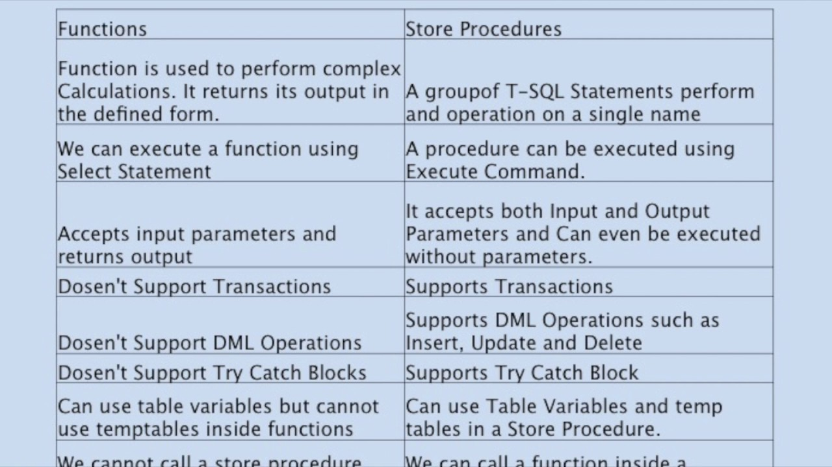
Procedures

Slide 26
Trigger
A trigger in a database is a set of SQL statements that are automatically executed (fired) in response to specific events on a particular table or view. Triggers help enforce business rules, maintain data integrity, and automate tasks. Events include INSERT, UPDATE, or DELETE operations on a table or view. Triggers are often used to validate data, log changes, or automate responses to changes in the database.
Key Features of SQL Triggers:
Automatic Execution: Triggers fire automatically when the defined event occurs (e.g., INSERT, UPDATE, DELETE).
Event-Driven: Triggers are tied to specific events that take place within the database.
Table Association: A trigger is linked to a specific table or view, and operates whenever changes are made to the table’s data.

Slide 27
Trigger
Key Terms
Create trigger [trigger_name]: Creates or replaces an existing trigger with the trigger_name.
[before | after]: This specifies when the trigger will be executed.
{insert | update | delete}: This specifies the DML operation.
On [table_name]: This specifies the name of the table associated with the trigger.
[for each row]: This specifies a row-level trigger, i.e., the trigger will be executed for each affected row.
[trigger_body]: This provides the operation to be performed as the trigger is fired

Slide 28
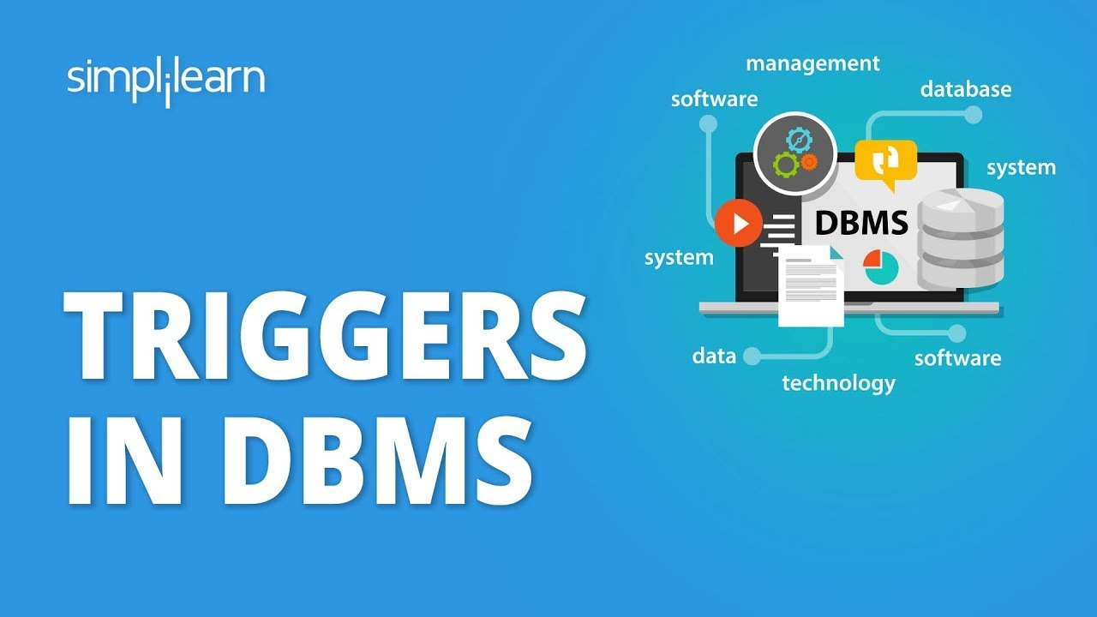
Types of Trigger
We can define 6 types of triggers for each table:
AFTER INSERT activated after data is inserted into the table.
AFTER UPDATE: activated after data in the table is modified.
AFTER DELETE: activated after data is deleted/removed from the table.
BEFORE INSERT: activated before data is inserted into the table.
BEFORE UPDATE: activated before data in the table is modified.
BEFORE DELETE: activated before data is deleted/removed from the table.

Slide 29

Trigger
Applications of Triggers:
Audit Trails: Automatically log changes to data.
Enforcing Constraints: Prevent invalid data modifications.
Synchronous Replication: Maintain a copy of data in another table.
Business Logic: Implement rules like updating inventory after a sale.

Slide 30
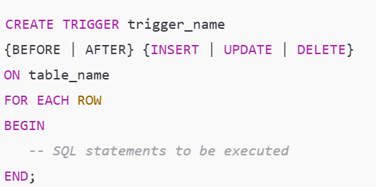
Syntax of Trigger

Slide 31

Steps to create a Trigger
Understand the Event: Decide on the event that will activate the trigger (e.g., INSERT, UPDATE, DELETE).
Define the Timing: Specify whether the trigger should execute BEFORE or AFTER the event.
Specify the Table: Choose the table the trigger will be associated with.
Write the Trigger Logic: Define the operations to be executed when the trigger is activated.
Test the Trigger: Ensure it works correctly and does not cause unintended side effects.

Slide 32
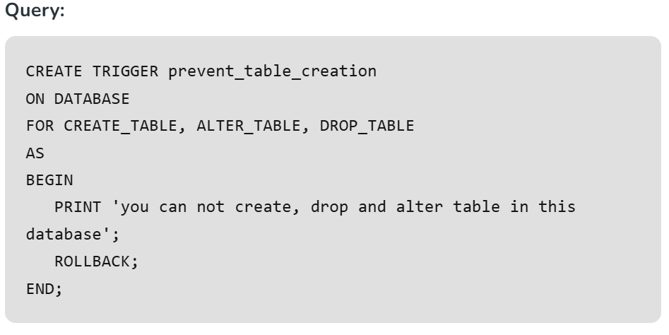
Types of SQL Triggers
1. DDL Triggers : The Data Definition Language (DDL) command events such as Create_table, Create_view, drop_table, Drop_view, and Alter_table cause the DDL triggers to be activated.

Slide 33
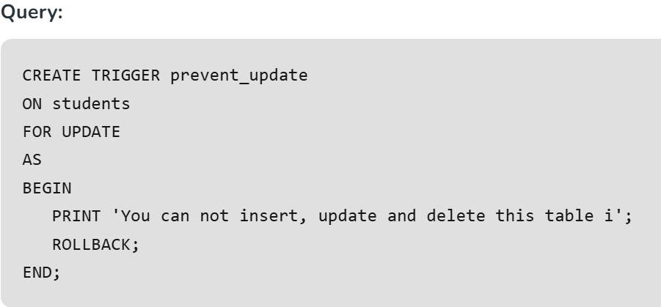
Types of SQL Triggers
2. DML Triggers: The Data manipulation Language (DML) command events that begin with Insert, Update, and Delete set off the DML triggers. corresponding to insert_table, update_view, and delete_table.

Slide 34
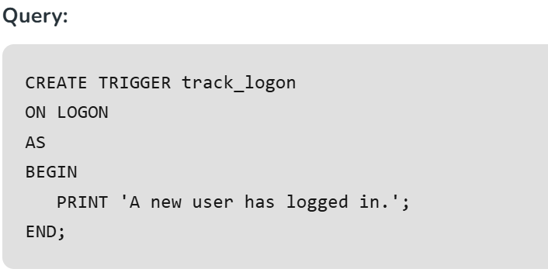
Types of SQL Triggers
3. Logon Triggers: These triggers are fired in response to logon events. Logon triggers are useful for monitoring user sessions or restricting user access to the database. As a result, the PRINT statement messages and any errors generated by the trigger will all be visible in the SQL Server error log. Authentication errors prevent logon triggers from being used. These triggers can be used to track login activity or set a limit on the number of sessions that a given login can have in order to audit and manage server sessions.

Slide 35
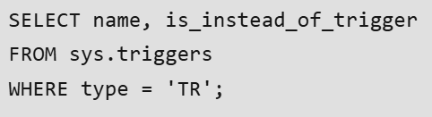
Trigger
Viewing Triggers Using SQL Query: If we are working with many tables across multiple databases, we can use a simple query to list all available triggers in our SQL Server instance. This is helpful for tracking and managing triggers, especially when dealing with tables that have similar names across databases.
Syntax:
Trigger
Key Terms
name: The name of the trigger.
is_instead_of_trigger: Whether the trigger is an INSTEAD OF trigger.
type = ‘TR’: This filters the results to show only triggers.

Slide 36
THANK YOU

